Slide 1
VIZ1, Session 3
Manipulating data

Slide 2

Grouping
Like SQL grouping
  A group is a subset of data with the same value
  The value is defined by a function
  Usually, we apply some sort of aggregate function to the group
  Aggregate functions in d3.js: https://d3js.org/d3-array/summarize
Visualizing groups
  Groups are often visualized by their sizes
  Kinds of charts:
    Bar chart
    Stacked bar chart
    Streamgraph

Slide 3
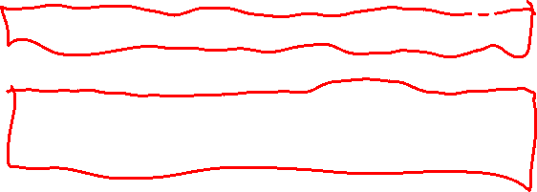
Grouping
Grouping creates a JavaScript Map
One entry per unique value
d3.group(data, d => d.name) will have keys A, B, and C
d3.group(data, d => d.category) will have keys 1 and 2
name | category | age
A | 1 | 12
B | 1 | 21
C | 1 | 15
B | 1 | 17
C | 2 | 22
C | 2 | 11

Slide 4
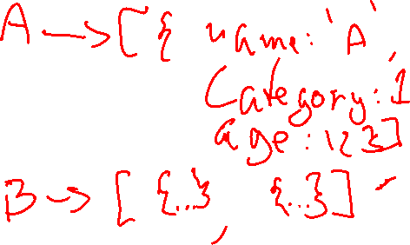
d3.group(data, d => d.name)
name | category | age
A | 1 | 12
B | 1 | 21
C | 1 | 15
B | 1 | 17
C | 2 | 22
C | 2 | 11

Slide 5
Grouping and aggregation
We’ll want compute some aggregate data to visualize
We did that last week
We can use this method, but sometimes there is a better way
const groups = d3.group(data, d => d.Country)
const bpByCountry = Array.from(groups,
([country, values]) => {
return {
country,
WHO_Region: values[0].WHO_Region,
averageDiastolic:
d3.mean(values,
d => d.Diastolic_BP_mmHg),
sampleSize: values.length
}
})

Slide 6
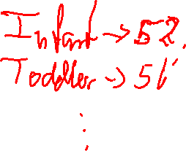
Rollup
Rollup Combines aggregation and grouping
The format is
d3.rollup(data,
aggregation function,
key function)
Suitable for a bar chart
const groupedData =
d3.rollup(
data,
group =>
d3.mean(group,
d => d.MAP),
d => d.Age_Group)

Slide 7
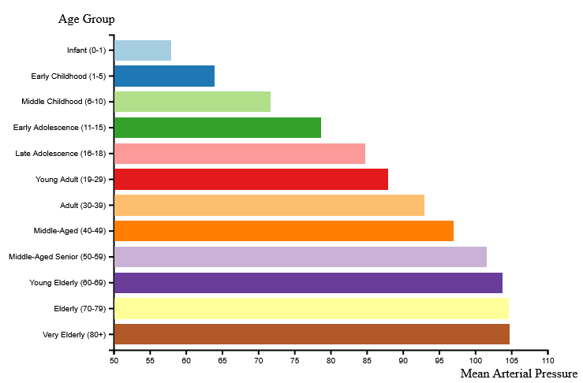
Bar Chart

Slide 8
Channels in a bar chart
Keys
  Keys are discrete (categorical or ordinal)
  Sometimes discrete keys are created through binning
  Channels used here are regions and colours
Values
  Values in a bar chart are sequential (quantitative, ordered from a minimum and up)
  The channel used is the length of the bar (size channel)

Slide 9
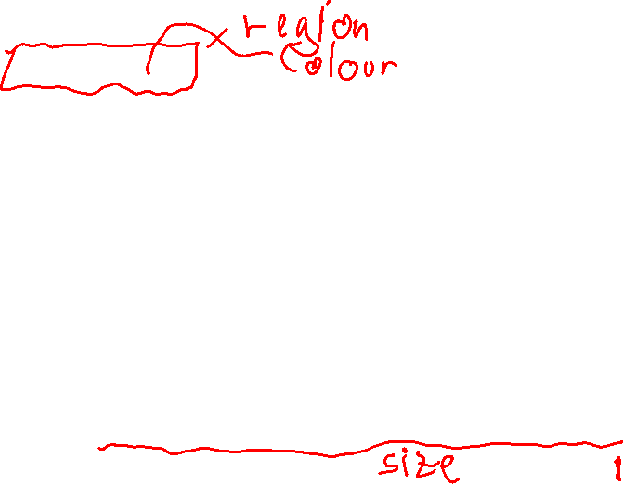
Bar Chart Channels

Slide 10
Multidimensional groups
Both group and rollup can create groups of groups
group:
  d3.group(data, key function 1, key function 2, …)
rollup:
  d3.group(data, aggregate function, key function 1, key function 2, …)
It creates a map of maps
We can visualize this with stacked bar charts or streamgraphs

Slide 11
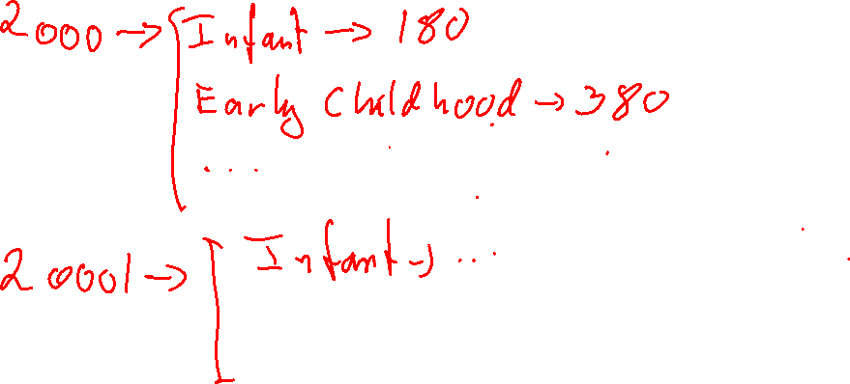
d3.rollup(data, d => d.length, d => d.Year, d => d.Age_Group)

Slide 12
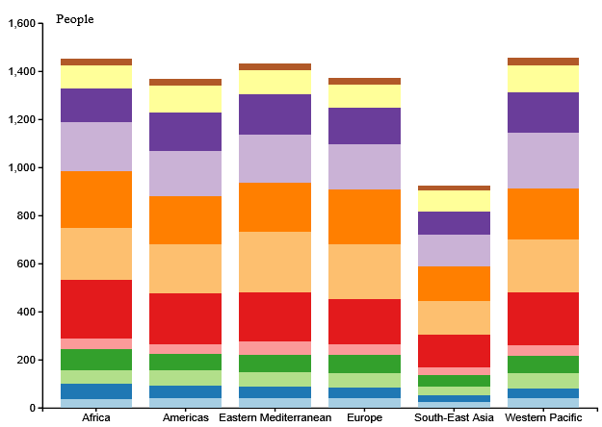
Stacked bar chart
Used to display 2-dimensional tabular data
Both dimensions are discrete (categorical/ordinal)
Why:
  Compare data
  Discover trends
  Lookup data (harder)

Slide 13
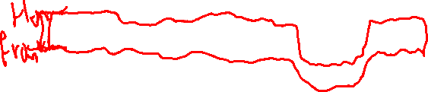
A stack in d3.js
An array of arrays of coordinates
Each element of the array corresponds to one of the colours on the right
The element is an array of [from, to] ranges of where the rectangle should be (in domain values)
But there is more

Slide 14
A stack
The elements of the stack array is an array of
  a 2-element array [from, to] with
  a data property with another 2-element array [key, map] from the original group/rollup
The array also contains an extra property, key of the (here age) group

Slide 15
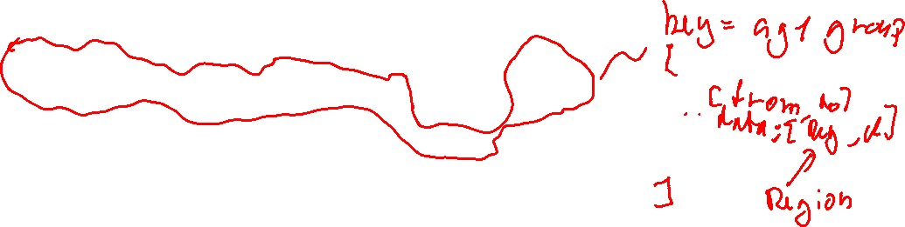
Stacks

Slide 16
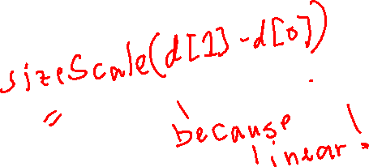
Drawing stacked bar chars
const ageGroupVis = visibleArea.selectAll(".ageGroupRects")
.data(stacks)
.join("g")
.attr("class", "ageGroupRects")
.attr("fill", d => ageGroupColorScale(d.key))
ageGroupVis.selectAll("rect")
.data(d => d)
.join("rect")
.attr("x", d => regionScale(d.data[0]))
.attr("width", regionScale.bandwidth())
.attr("y", d => sizeScale(d[1]))
.attr("height", d => sizeScale(d[0]) - sizeScale(d[1]))

Slide 17
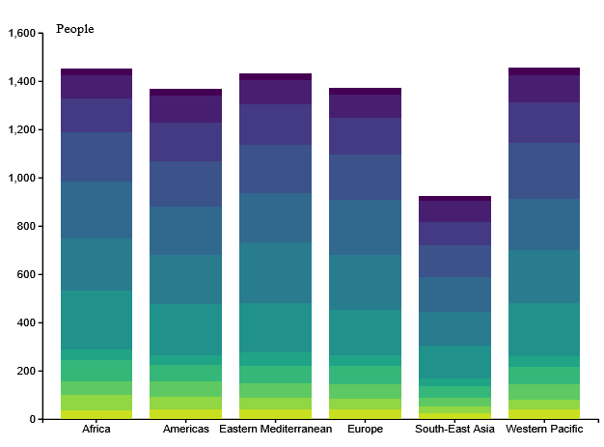
Colour choice
Age group is categorical (unordered)
Age group is ordinal (discrete, sequential)

Slide 18
Demo

Slide 19
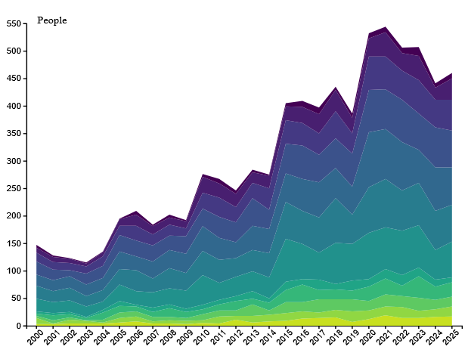
Streamgraph

Slide 20
Channels in a Streamgraph
Keys
  Keys are discrete (categorical or ordinal)
  Sometimes discrete keys are created through binning
  Channels used here are regions and colours
Values
  Values in a streamgraph are sequential (quantitative, ordered from a minimum and up)
  The channel used is the position on the y-axis

Slide 21
Streamgraph
Used to display 2-dimensional tabular data
Both dimensions are discrete (categorical/ordinal)
Why:
  Compare data
  Discover trends
  Enjoy trends

Slide 22
Creating areas
const areaGenerator = d3.area()
.x(d => yearScale(d.data[0]) + yearScale.bandwidth() / 2)
.y0(d => sizeScale(d[0]))
.y1(d => sizeScale(d[1]))

Slide 23
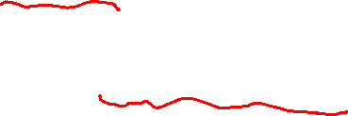
Drawing the streamgraph
visibleArea.append('g')
.attr('class', 'graph')
.selectAll("path")
.data(stacks)
.join("path")
.attr("d", areaGenerator)
.attr("fill", d => ageGroupColorScale(d.key))

Slide 24
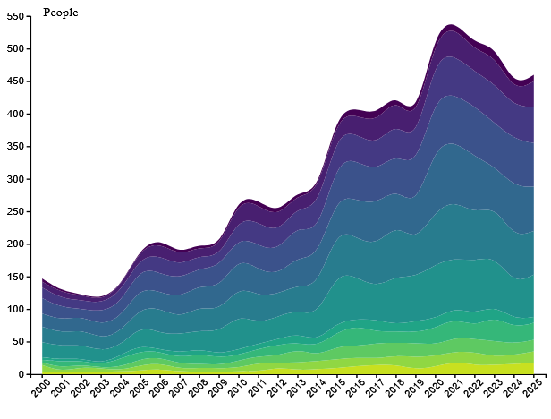
Enjoying the data: Smoother curves
const areaGenerator = d3.area()
.x(d =>
yearScale(d.data[0]) +
yearScale.bandwidth() / 2)
.y0(d => sizeScale(d[0]))
.y1(d => sizeScale(d[1]))
.curve(d3.curveBasis)

Slide 25
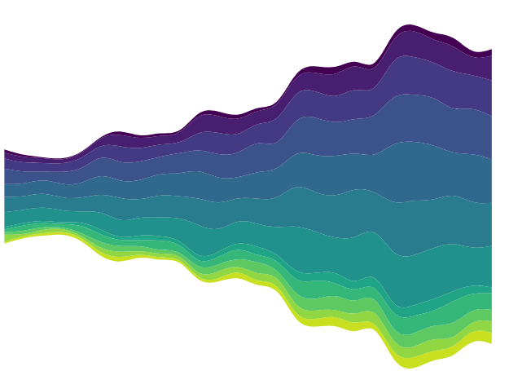
Enjoying the data: Centering
const areaGenerator = d3.area()
.x(d =>
yearScale(d.data[0]) +
yearScale.bandwidth() / 2)
.y0((d, i) =>
sizeScale(d[0]
- annualSizes[i] / 2)
- center)
.y1((d, i) =>
sizeScale(d[1]
- annualSizes[i] / 2)
- center)
.curve(d3.curveBasis)

Slide 27
Exercise
Try this on the uploaded template project and data

